Slide 1
Emeritus Application Profile
Mr. Lee A. Jeffrey
Little Rock Produffers Southwest Emeritus
September 2020

Slide 3
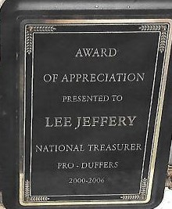

Slide 4
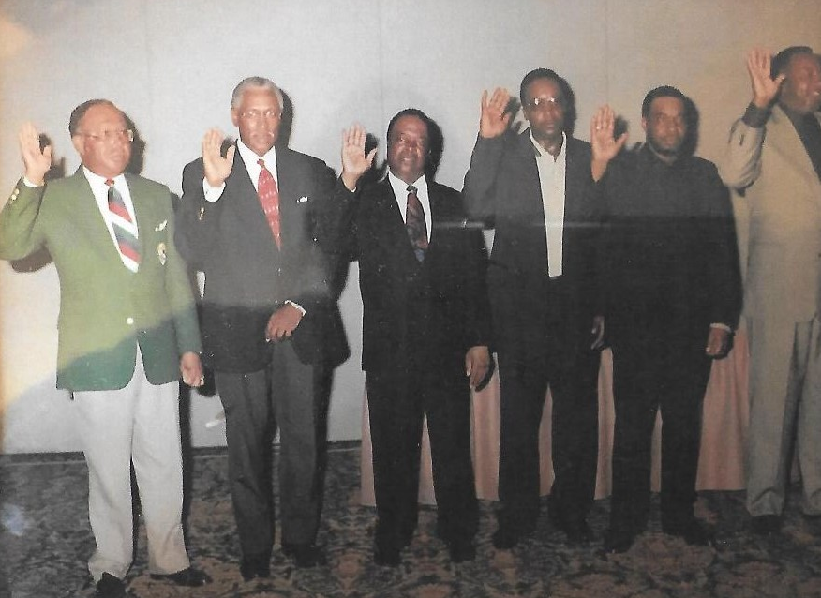

Slide 5
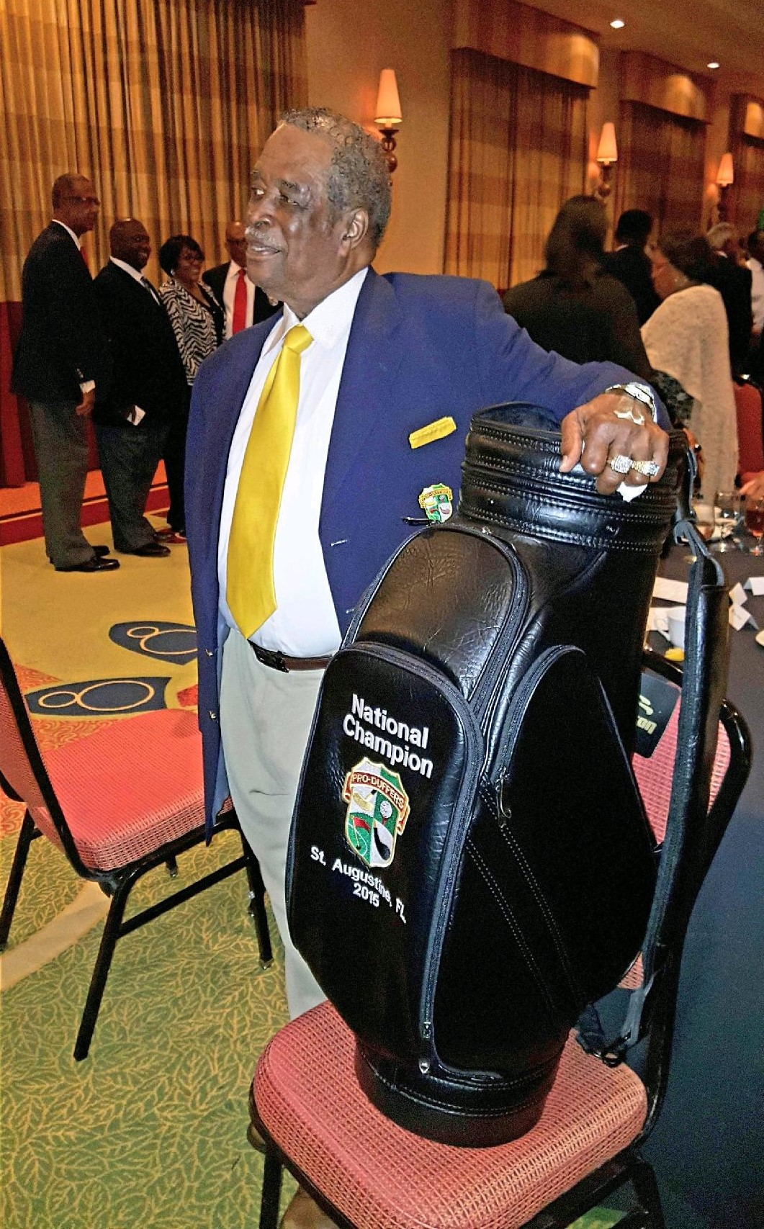

Slide 6
I Mr. Lee A. Jeffrey want to thank
ProDuffers USA for accepting my application
For Emeritus Status.
Thanks Again

